Slide 1


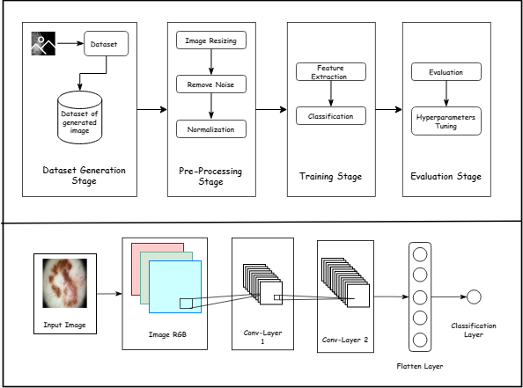

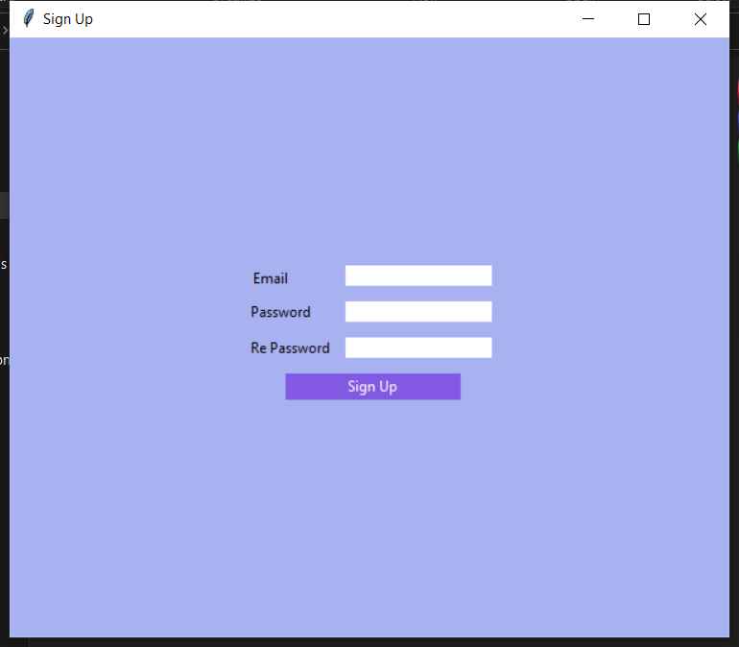
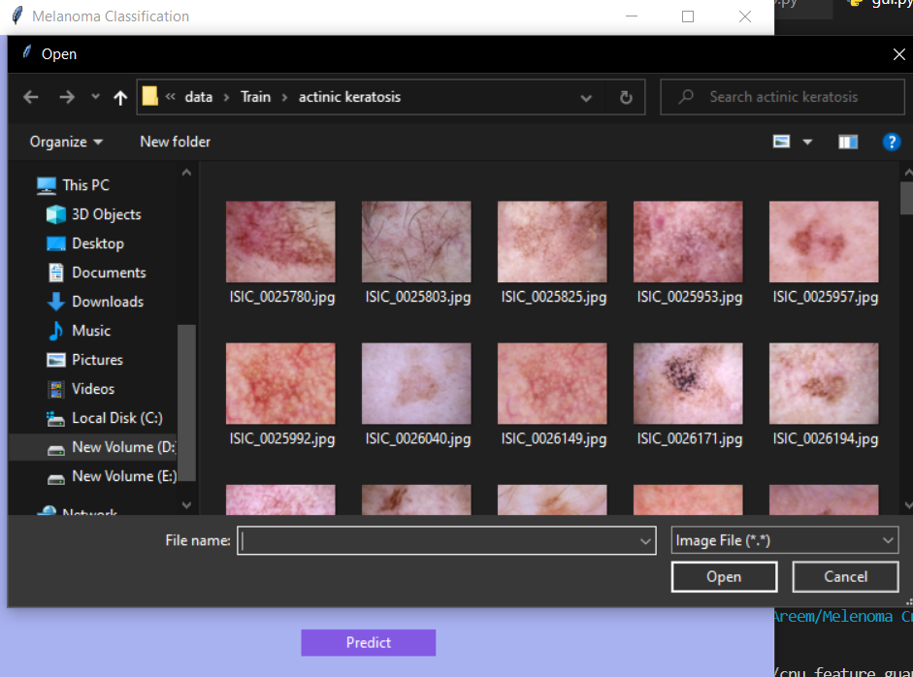
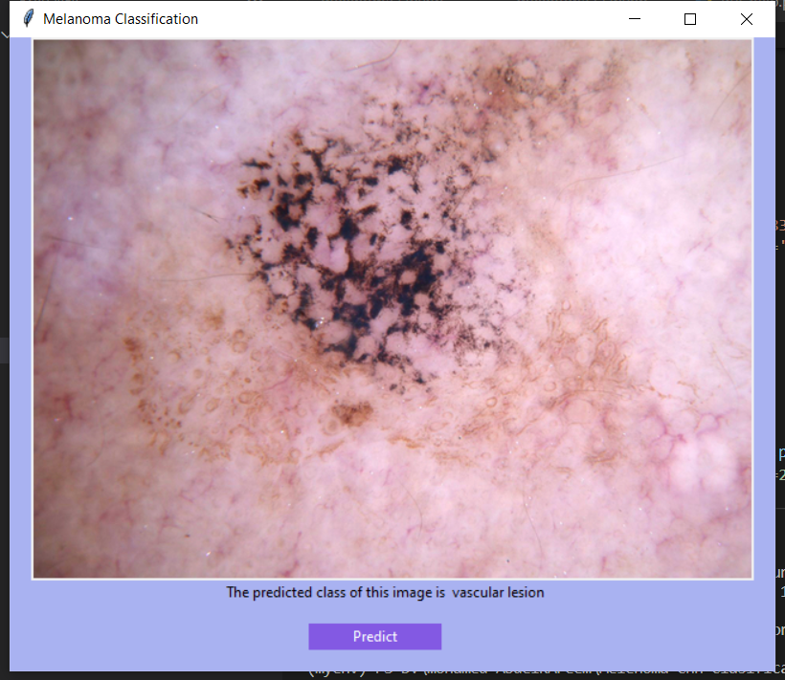
Melanoma Classification Model Using Machine Learning
Al Imam Mohammad ibn Saud Islamic University
College of Sharia and Islamic Studies in Al-Ahsa
Computer and Information Science Department
By: Mohammed Al-Klulaib, Khaled Al-Qahtani, Saad Al-Dossari, Fahad Al-Taher
Supervised by: Dr. Mohammed Abu Al-Rub
Skin cancer develops when
abnormal skin cells grow out of control, causing the skin to quickly proliferate and develop cancerous tumors. The number of new aggressive Melanoma cases significantly increased by 54% between 2008 and 2019 . People under 40, particularly women, appear to be at increased risk for Melanoma. It is possible to prevent the spread of skin cancer by being aware of the warning signals of the condition. Early detection is key to the successful treatment of Melanoma. Most skin lesions become malignant because of a failure to pay attention to skin lesions on their body's surface or a lack of access to skilled dermatologists.
clinicians frequently misdiagnosed skin lesions
Researchers have discovered that skin cancer increases the chance of other cancers, thus early detection of skin cancer is critical since it can dramatically reduce death from this dangerous malignancy .
Introduction
Aims and Objectives
In this project, we aim to build a model using machine learning with a classification model for classifying the images as Melanoma or not by CNN.
Objectives:
To reduce the ill effects and different artifacts such as hair that may be present in thermoscopic images.
To determine the location of a lesion using the image segmentation technique.
To choose the most accurate model.
Automated melanoma detection in dermo copy images is a very difficult task. To address these difficulties, based on what has been provided before from systems similar to ours, there are a few aspects that need to be enhanced to achieve a perfect system. To acquire the best accuracy, use a variety of classification algorithms and adjust the hyperparameters of each kind. Second, the solution should be applied to an appropriate dataset, not only to thermoscopic images.
Method
Reference
[1]Pillay, Pillay V., Hirasen, D., Viriri, S., & Gwetu, M. (2020). Melanoma Skin Cancer Classification Using Transfer Learning. Advances in Computational Collective Intelligence, 287–297 https://doi.org/10.1007/978-3-030-63119-2_24.
[2]Melanoma - Symptoms and causes. (2022, June 18). Mayo Clinic. Retrieved September 12, 2022, from https://www.mayoclinic.org/diseases-conditions/Melanoma/symptoms-causes/syc-20374884#:%7E:text=Melanoma%2C%20the%20most%20serious%20type,in%20your%20nose%20or%20throat.
[3]Society AC. Cancer Facts and Figures 2020. Atlanta: American Cancer Society; 2020; available from:https://www.aimatMelanoma.org/about-Melanoma/Melanoma-stats-facts .
Conclusion
Results
Problem Statement

